Slide 1
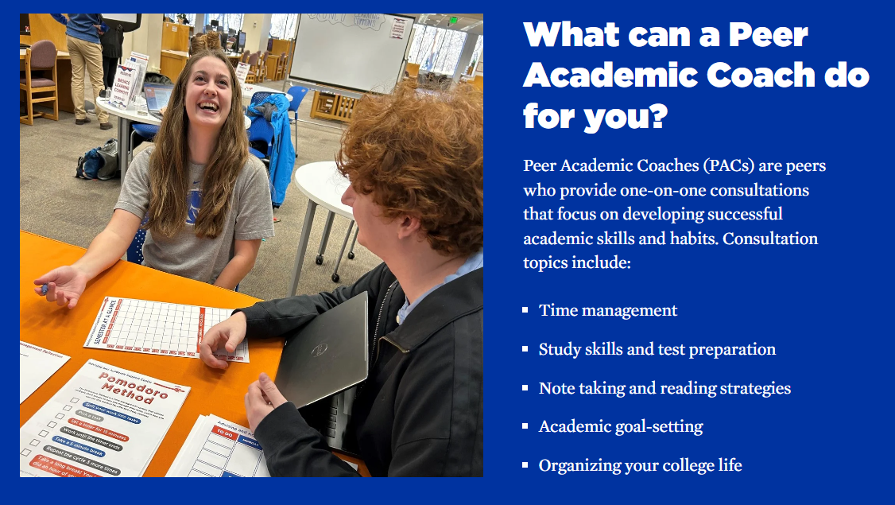
Campus Resource: Peer Academic Coaching
Make an Appointment

Slide 2
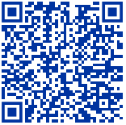
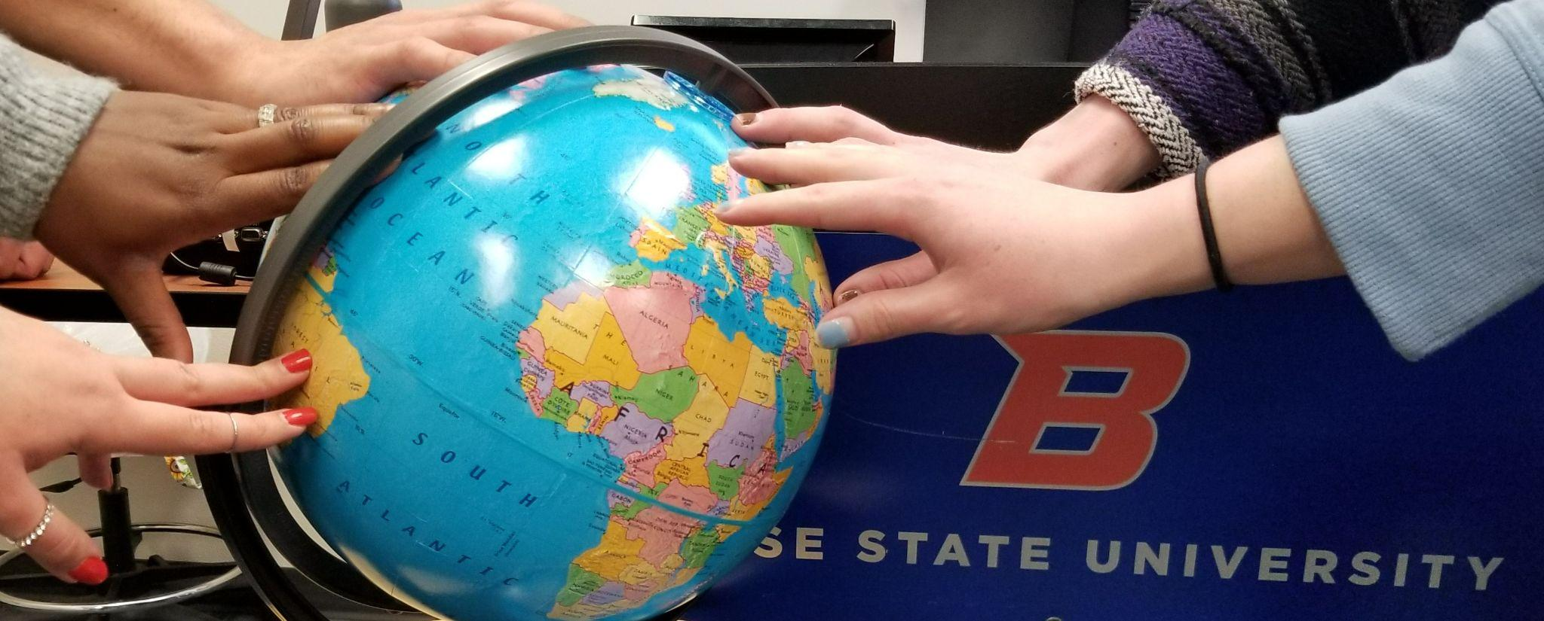
English Language Support Programs
Free weekly tutoring for multilingual students!
Complete your homework faster
Improve your grades
Make a friend (tutors are undergraduate students)
Get advice on how to “do college” (talk to professors, use Canvas)
englishsupport@boisestate.edu

Slide 3
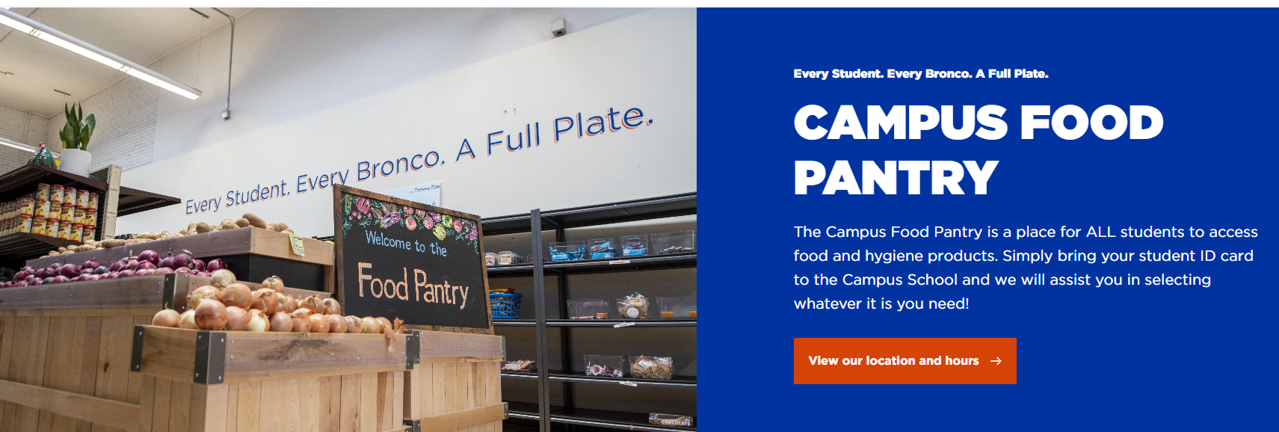
Featured Resource: Food Pantry
Thousands of visits per month. Learn More.

Slide 4
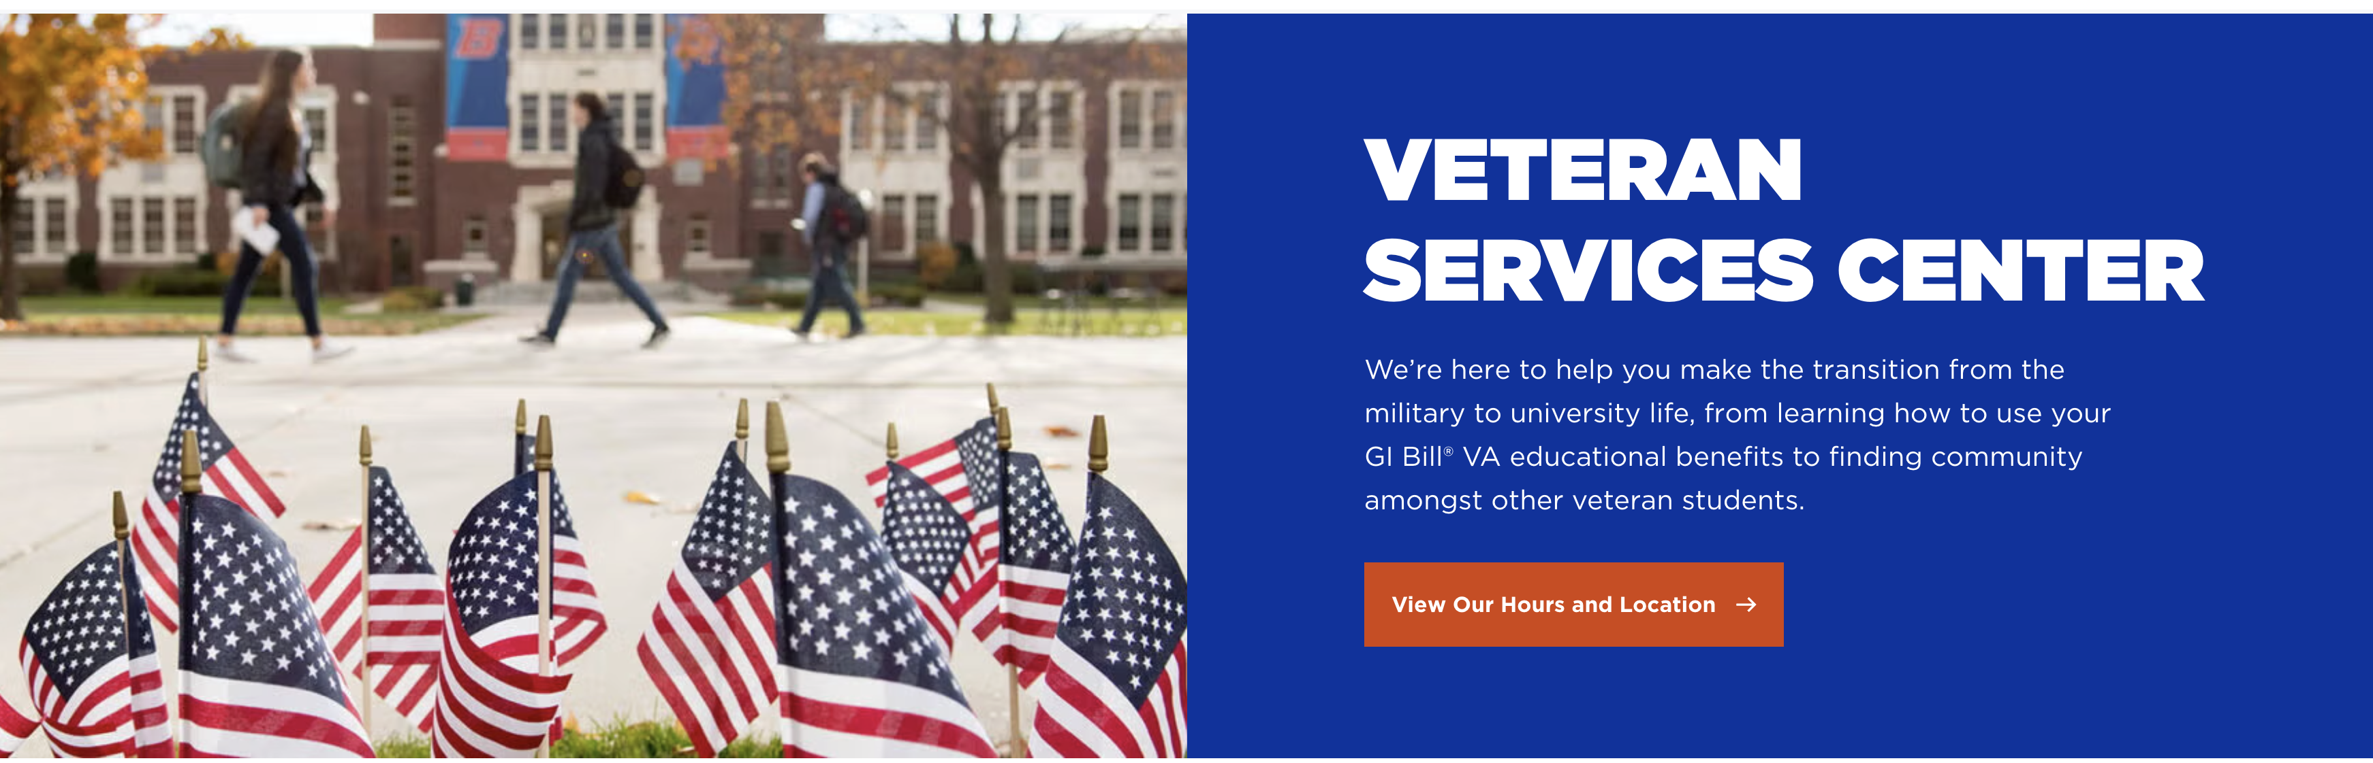
Veteran Services Center Located at Lincoln Garage

Slide 5
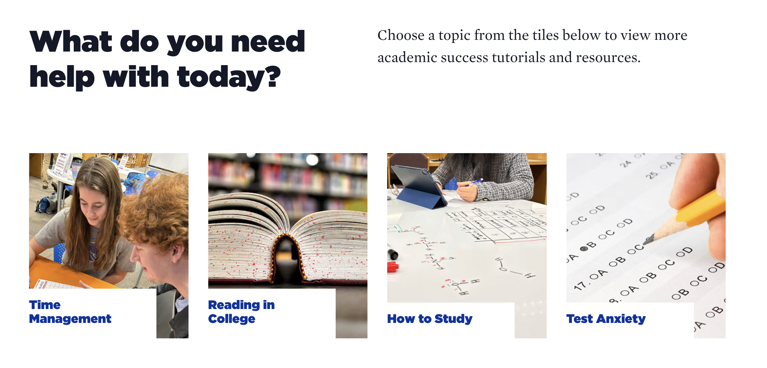
Advising and Academic Support (boisestate.edu/aasc)

